Slide 1
Software Testing
Muhammad Asaduzzaman
University of Windsor
Special thanks to Chanchal Roy (University of Saskatchewan) for granting access to the content of this slides

Slide 2
Testing
Testing is the process of executing software in a controlled manner to answer the question:
“does the software behave as specified?”
  Implies that there must be a specification before there can be meaningful testing
  Or implies that we have some property we wish to test for
    “all paths in the code are reachable (no dead code)”
Testing is often associated with the words “validation” and “verification”

Slide 3
Validation and Verification
Validation
  does the software system meets the user's real needs?
are we building the right software?
  Validation usually involves meetings, reviews and discussions, to check that what has been specified is what was intended
Verification
  does the software system meets the requirements specifications?
are we building the software right?
  Verification is the checking or testing of software (or anything else) for conformance and consistency with a given specification

Slide 4
Validation and Verification
SW
Specs
Actual
Requirements
System
Validation
Verification
Includes usability testing, user feedback
Includes testing, inspections, static analysis

Slide 5
Cost of Testing
Testing is expensive
The investment in testing should be based on the cost of errors that will occur if thorough testing is not done
Exhaustive testing is usually impossible
Testing may cost as much as system development
Often testing is carried out by a separate testing team

Slide 6
Classical Levels of Testing
Acceptance testing: Is the software acceptable to the user?
main Class P
System testing: Test the overall functionality of the system
Class A
Class B
Integration testing: Test how modules interact with each other
method mA1()
method mB1()
method mA2()
method mB2()
Module testing: Test each class, file, module or component
Unit testing: Test each unit (method) individually

Slide 7
Poor (commonly used) testing Practices
Major Poor Testing Practices
  Testing to prove the system works, not to find what is wrong with it
  No test plan
  Poor test data
  Proper testing tools not used
  Poor testing of user’s understanding
  Poor testing of surrounding context of use
We need to apply systematic testing

Slide 8
Systematic Testing
A systematic test method must have
  a system (rule) for creating tests
  a measure of completeness
  Need an easy, systematic way to create test cases
    to know for sure what to test
  need an easy, systematic way to run tests
    to know how to test
  need an easy, systematic way to decide when we are done
    to know when we have enough tests

Slide 9
Testing: A few Definitions
“Testing is the process of executing a program with the intent of finding errors“ [Myers]
Test coverage is the degree to which the complete set of program elements is executed.
A test case consists of execution conditions, input data, and expected results.
A test suite is a set of test cases.

Slide 10
Systematic Testing Methods
Black box methods
White box methods

Slide 11
Systematic Testing Methods
Black box methods
  Cannot see what software code to test
  Code may not exist yet
  So they can only base their tests on the requirements or specifications
White box methods
  Can see what the software’s code to test
  So they can base their tests on the software’s code itself

Slide 12
Kinds of White Box Testing
Code Coverage
  Code coverage methods design tests to cover (execute)
    every method, statement or instruction of the program at least once
Logic Path / Decision Point Coverage
  Logic path methods design tests to cover
    every path of execution in the program at least once
    E.g., true/false paths of an if condition.
Mutation Testing
  Mutation testing involves creating many slightly different versions of the code by mutating (changing operations) in each version
  Used to check sufficiency of test suites in detecting faults
  Are the test suites sufficient enough? Need more test data?

Slide 13
Statement Coverage Method
Causes every statement in the program to be executed at least once,
  giving us confidence that every statement is at least capable of executing correctly
System: Make a test case for each statement in the program, independent of the others
  Test must simply cause the statement to be run, ignoring its actions and substatements (but still must check that result of test is correct)
Completion criterion: A test case for every statement
  Can be checked by instrumentation injection to track statement execution coverage

Slide 14
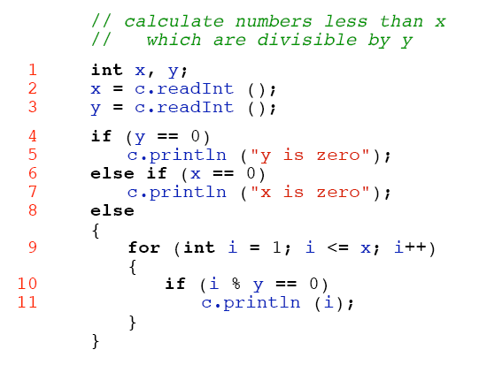
Example: Statement Coverage

Slide 15
What is the Target?
=> Find the Test Suite.
A set of input data that will cause every statement to execute.
What are the input variables in the program?
  Declarations, global variables, function parameters
What are the statements? Line numbers?
  Each line of code
Attempt to choose the atomic values such as 0, 1, -1 and so.
Get each unique set of inputs as test case.
  Generate the test suite

Slide 16
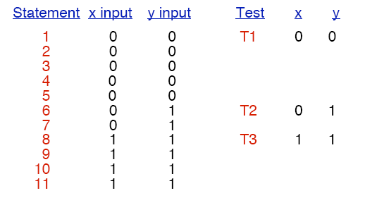
Example: Statement Coverage Tests
We blindly make one test for each statement,
  analyzing which inputs are needed to cause the statement to be executed
  Create test case for each unique set of inputs

Slide 17
Decision Coverage Method
Causes every decision in the program to be made both ways (or every possible ways for switch)
System: Design a test case to exercise each decision in the program each way (true / false)
Completion criterion: A test case for each side of each decision
Can be checked by instrumentation injection to track branches taken in execution
Notes:
(if, switch, while, etc.) are places where you make decisions

Slide 18
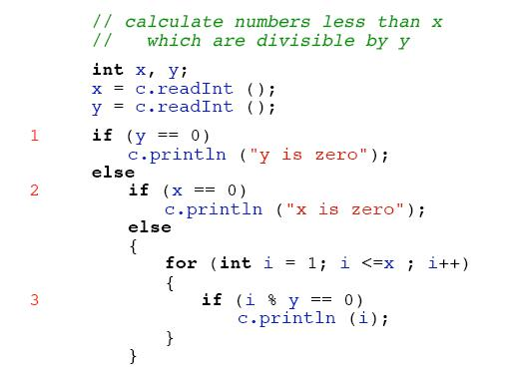
Decision Coverage: What are the decisions?

Slide 19
Decision Coverage: What are the decisions?
1
2
3

Slide 20
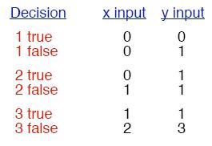
Example: Decision Coverage
Decision Coverage Tests
  We make one test for each side of each decision (both for true and false cases)
1
2
3

Slide 21
Mutation Testing?
Another kind of widely used white box testing is Mutation Testing
  Definition and role of mutation testing
  what is a mutation?
  how is mutation testing used?
    mutation testing methods
    value mutations
    decision mutations
    other mutations
    examples

Slide 22
Why do we need Mutation Testing?
Mutation testing is a white box method
  for checking the adequacy of a test suite
As you have already discovered,
  creating a test suite can be an expensive and time consuming effort
No matter what test method is used,
  discovering if test suites are adequate to uncover faults is itself an even more difficult task
Mutation testing offers an almost completely automated way
  to check the adequacy of a set of tests in uncovering faults in the software

Slide 23
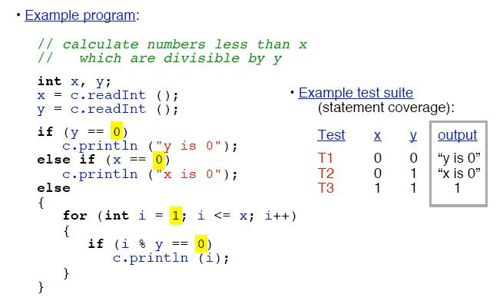
Adequacy of a Test Suite
Is this test suite sufficient
enough to uncover hidden faults?
23

Slide 24
What is a Mutant?
Line Original Mutant Line
1
2
3
4
5
6
7
8
if (x==5)
{
a=1;
}
else
{
a=0;
}
if (x==5)
{
a=0;
}
else
{
a=0;
}
1
2
3
4
5
6
7
8
Single small change

Slide 25
What is “Killed a Mutant”?
Line Original Mutant Line
1
2
3
4
5
6
7
8
if (x==5)
{
a=1;
}
else
{
a=0;
}
if (x==5)
{
a=0;
}
else
{
a=0;
}
1
2
3
4
5
6
7
8
Single small change
Do they have the same set of output for the same set of input?
  Yes, NOT killed.
  No, KILLED

Slide 26

The Mutation Process
Program
If program is not error-free, fix it
Create Mutants
Test
Program
Mutation
Test Suite
Problem with Tests?
Mutation
New Test Data
Mutation
Test Mutants
Yes
Any Mutations that are caught by tests are killed
Any Live Mutants?
Test Complete
No

Slide 27
How does Mutation Testing work?
In order to test the adequacy of a test suite,
  we first run the software on the suite and fix any problems until we are satisfied that the software passes the tests
We then save the results of the tests in a file or set of files
  to serve as the correct output to compare to
We then use mutation of the source code
  to create a set of mutants, each of which is a program slightly different from the original
For each mutant, we run the test suite on the mutant and
  compare the results to the saved results from the original
If the results differ,
  then the mutant has been “killed” (detected) by the test suite
If the results do not differ,
  then the test suite is inadequate to detect the mutant, and a new test must be added to the suite to “kill” that mutant

Slide 28
Systematic Mutation: Mutants
In order for mutation testing to be systematic,
  System: and a
  completion criterion for creating mutants
Example systematic mutations are:
  value mutations (changing constants or parameters by adding or subtracting one, etc.)
  decision mutations (inverting or otherwise modifying the sense of each decision condition in the program)
  statement mutations (deleting or exchanging individual statements in the program)
Each mutant has exactly one change in it
When are we done?
  when every possible single change mutant of the system has been generated and tested

Slide 29
Example 1: Value Mutation
System
  Mutate the value of each constant in the program to be off by one (or more generally, each integer expression)
Completion criterion
  One mutant for each constant in the program

Slide 30
Example 1: Value Mutation

Slide 31
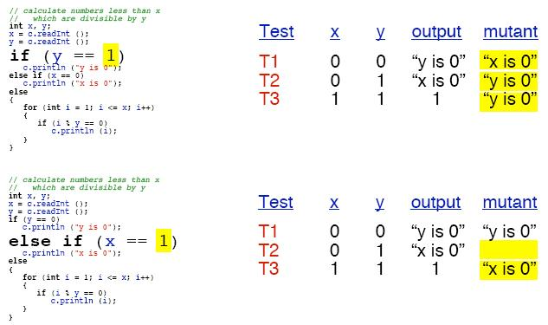
Example 1: Value Mutation
“x is 0”
“y is 0”
“y is 0”
“y is 0”
“x is 0”

Slide 32
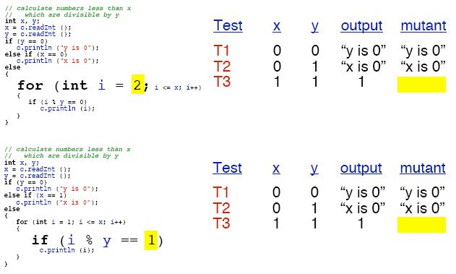
Example 1: Value Mutation
“y is 0”
“x is 0”
“y is 0”
“x is 0”
All mutants turn out to be “killed”. Thus the test suite seems adequate to test the program

Slide 33
Example 2: Decision Mutation
System
  Invert the sense of each decision condition in the program
  (e.g., change > to <, == to !=, and so on)
Completion criterion
  One mutant for each decision condition in the program

Slide 34
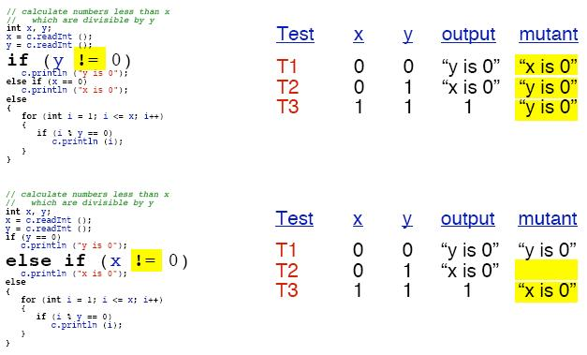
Example 2: Decision Mutation
“x is 0”
“y is 0”
“y is 0”
“y is 0”
“x is 0”

Slide 35
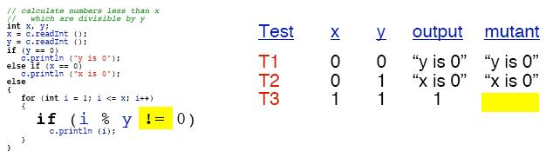
Example 2: Decision Mutation
“y is 0”
“x is 0”
All mutants turn out to be “killed”. Thus the test suite
seems adequate to test the program

Slide 36
Example 3: Statement Mutation
System
  Delete each statement in the program
Completion criterion
  One mutant for each statement
Note that there are many other possible statement mutations:
  interchanging adjacent statements
  shuffling sequences of statements
  doubling statements
  many more

Slide 37
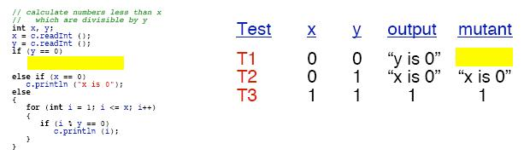
Example 3: Statement Mutation
“x is 0”
1
This time, we show only one example - you can make the rest!
Again, all mutants turn out to be “killed”

Slide 38
OO Mutation (1)
So far, operators only considered method bodies
Class level elements can be mutated as well:
public class test {
public void do() {
…
}
}
public class test {
private void do() {
…
}
}

Slide 39
OO Mutation (2)
AMC - Access Modifier Change
HVI - Hiding Variable Insertion
OMD - Overriding Method Deletion
OMR - Overridden Method Rename
SKR - Super Keyword Deletion
PCD - Parent Constructor Deletion
ATC - Actual Type Change
DTC - Declared Type Change

Slide 40
OO Mutation (3)
PTC - Parameter Type Change
RTC - Reference Type Change
OMC - Overloading Method Change
OMD - Overloading Method Deletion
AOC - Argument Order Change
ANC - Argument Number Change
TKD - this Keyword Deletion
SMV - Static Modifier Change

Slide 41
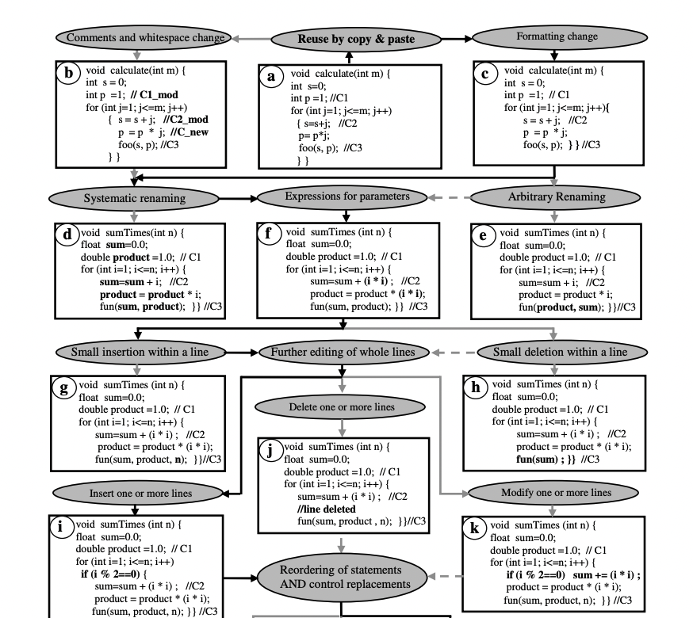

Slide 42
Interface Mutation
Integration testing
Change calling method by modifying the values that are sent to a called method
Change a calling method by modifying the call
Change a called method by modifying the values that enter/leave the method
Change a called method by modifying statements that return from the method

Slide 43
Mutation Testing Tools
Some open source mutation testing tools
  http://java-source.net/open-source/testing-tools
Java mutation testing for Eclipse: JMuTE
  http://sourceforge.net/projects/jmute/
Another good one: muJava
  http://cs.gmu.edu/~offutt/mujava/
  Both traditional and class-level mutation testing

Slide 44
Mutation Testing: Summary
Mutation Testing is a glass/white box method
  for automatically checking test suites for completeness
Mutations are simple, syntactic variants of programs
  that can be generated automatically
Typical mutations are
  value mutations,
  decision mutations,
  statement mutations
Statement coverage is a strong testing system,
  “kills” most kinds of mutants

Slide 45
Acknowledgements
This lecture has been prepared with the help of many others, special thanks to
  Jim Cordy, Queen’s University
  Gord McCalla, University of Saskatchewan
  Paul Ammann, George Manson University
  Jeff Offutt, George Manson University
  Mauro Pezzè, University of Milano Bicocca
  Michal Young, University of Oregon Eugene

